Slide 1


Yelp Pizza Restaurants’ Review Analysis
Group2
Jiacheng Miao,Hao Qin,Shirley Zhang,Xiyue Wang

Slide 2

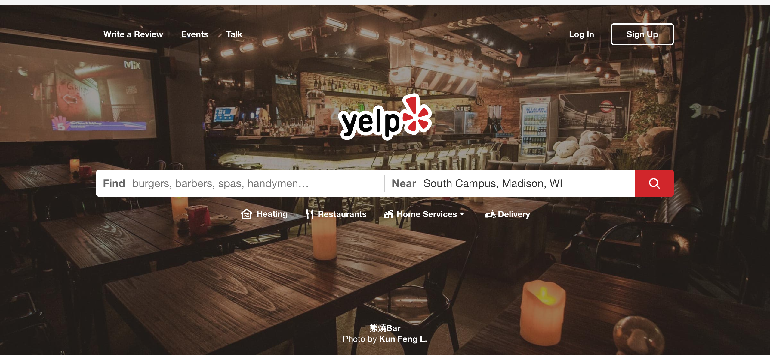
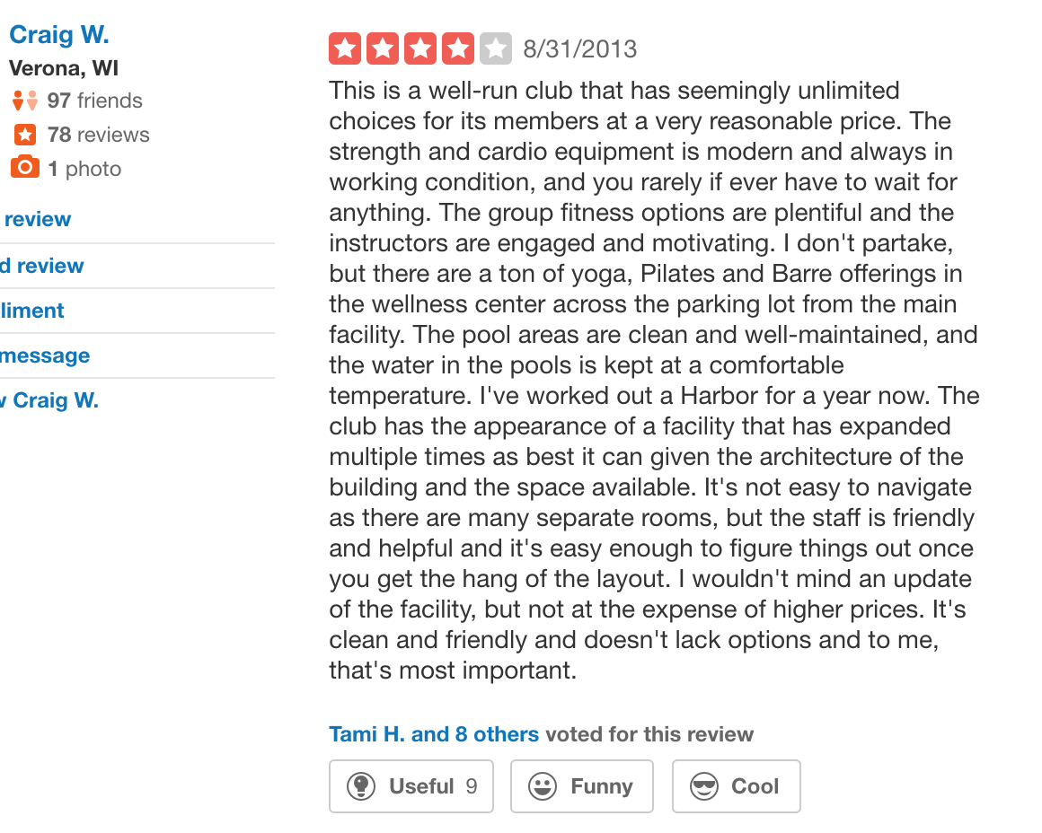
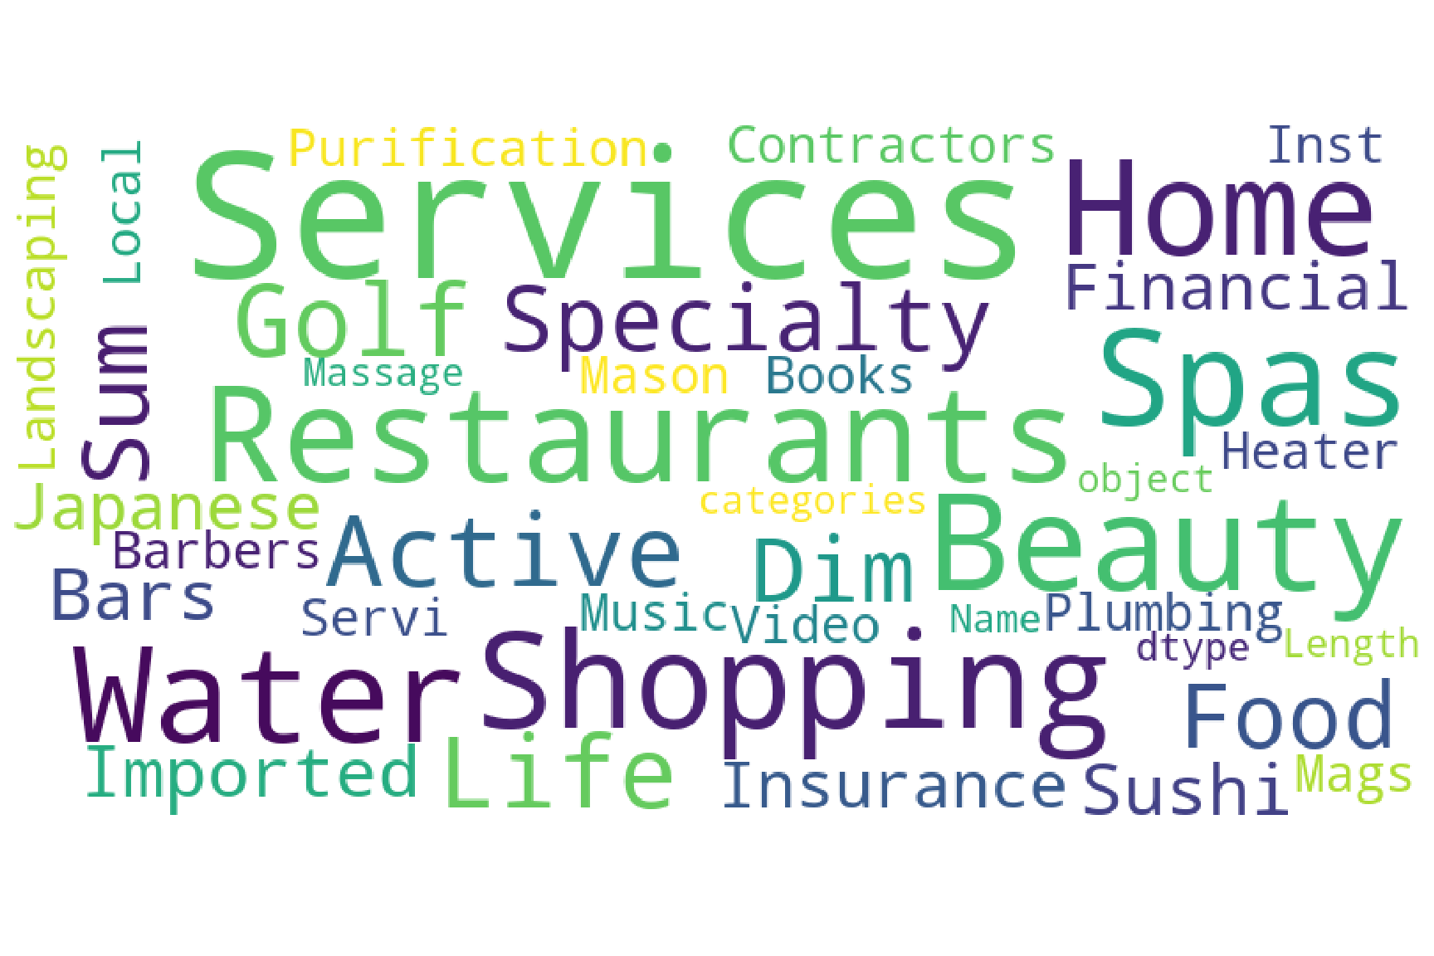
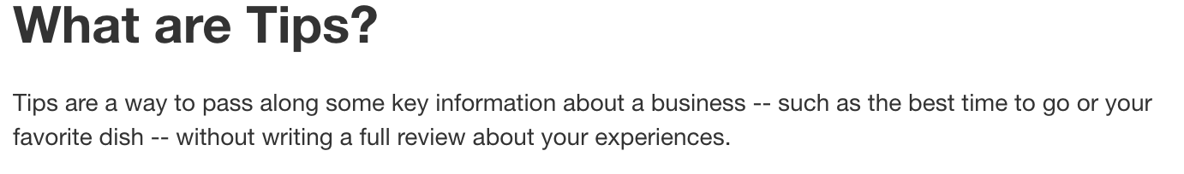
Introduction
Yelp
Yelp is a local business directory service and review site with social networking features. It allows users to give ratings and review businesses.
Recently, Yelp has released some of its 171 million reviews to the public as a part of the “Yelp Dataset Challenge.”
Dataset description: JSON files
review json: Contains 6,685,900 reviews
business.json: Contains information about 192,609 businesses.
user.json: Contains information about 1,637,138 million users.
tip.json: Contains information about 1,223,094 tips written by users on a business

Slide 3
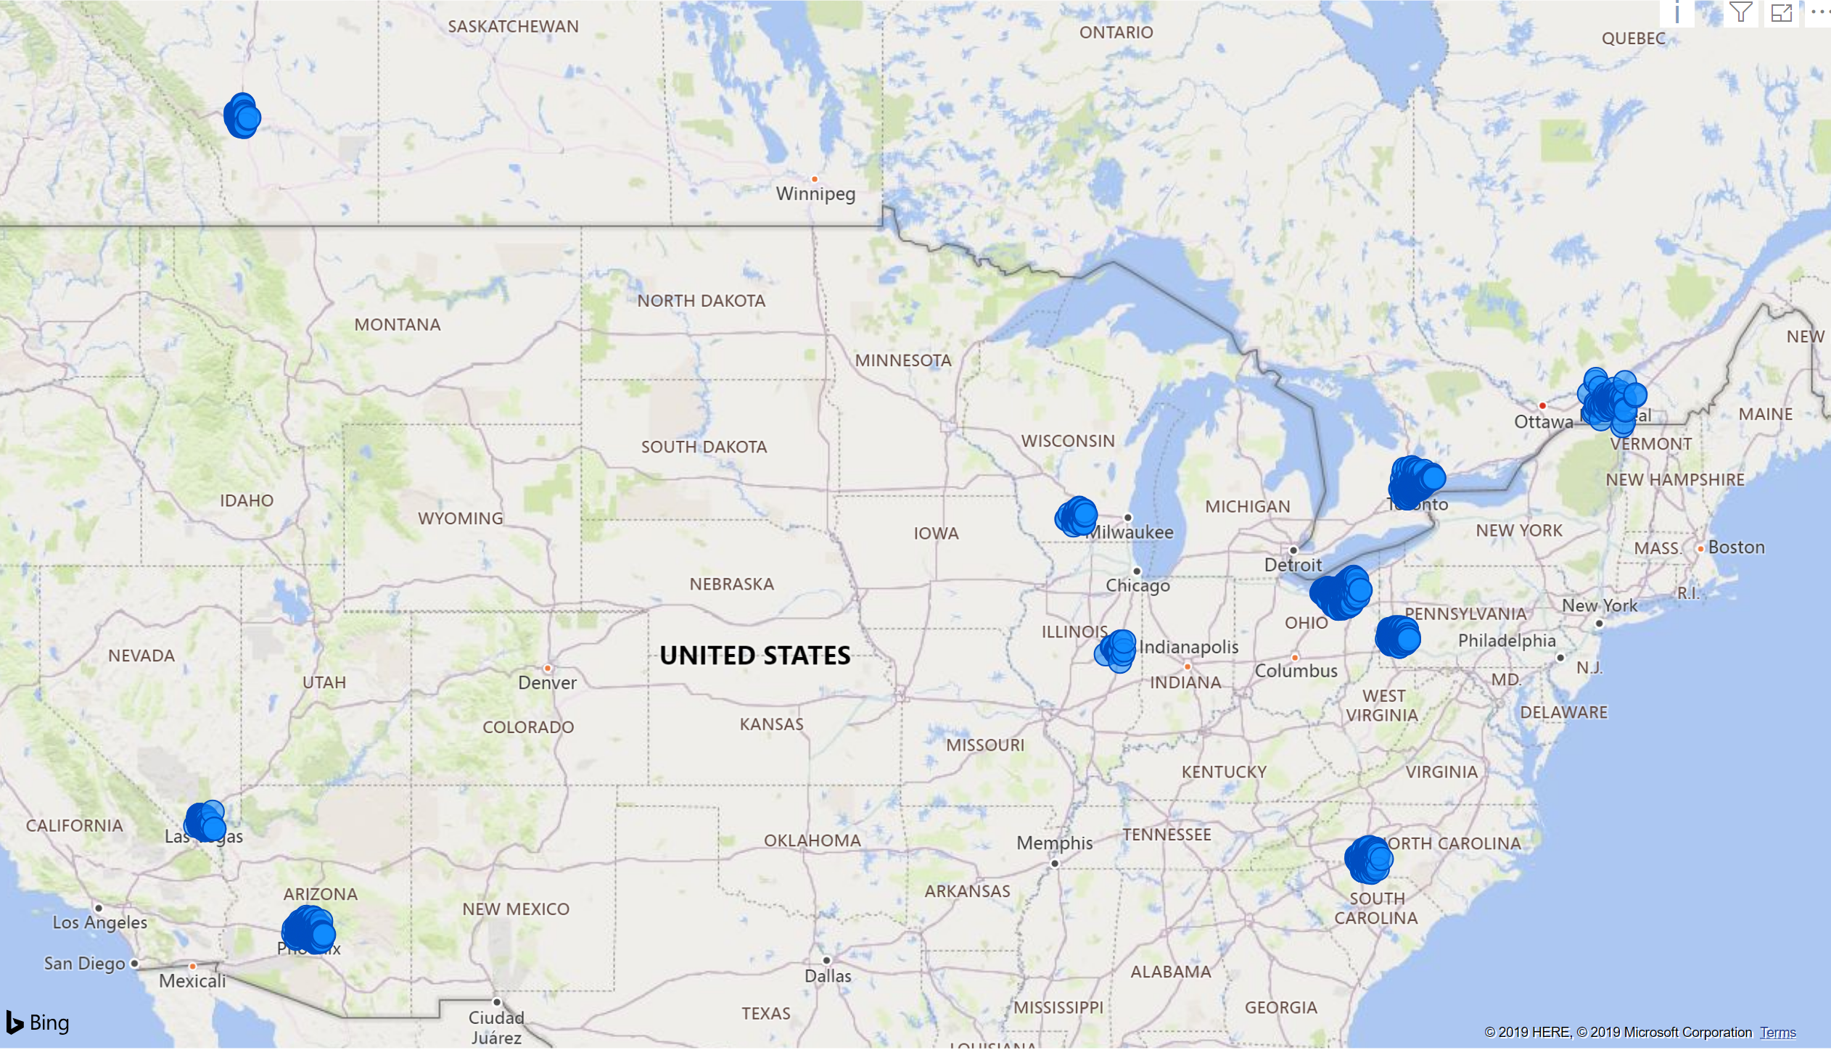
Goal
From the brand perspective, provide useful, analytical insights to pizza restaurant owners, especially the Top 1 chain restaurant Pizza Hut on Yelp.
Build a web application that visualizes our analysis and makes it easier to understand for Top 10 pizza restaurant owners in Wisconsin.

Slide 4
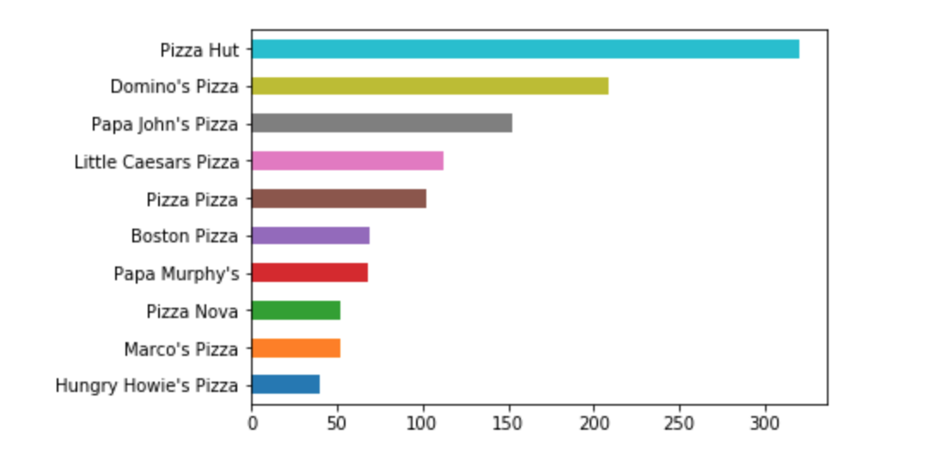
Top 10 Pizza

Slide 5
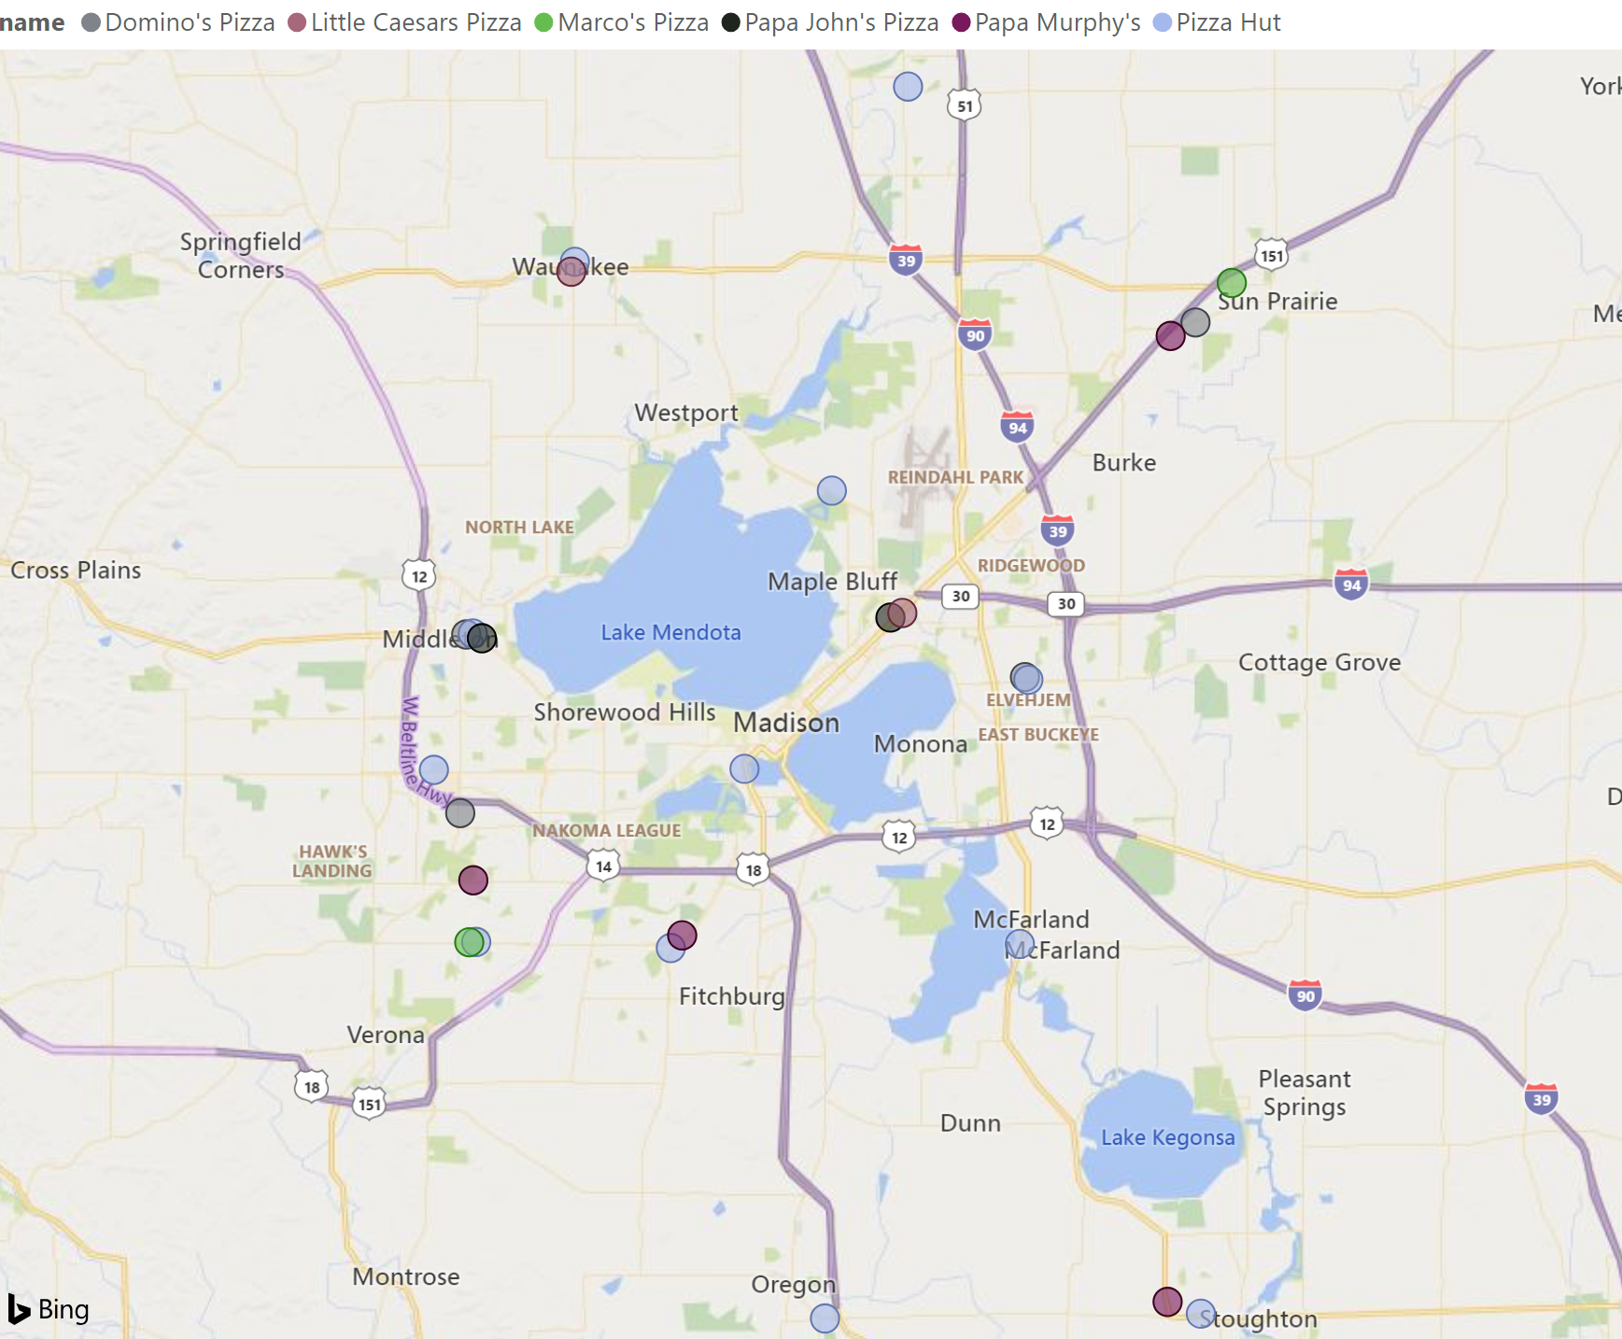
Top 10 Pizza
In Madison
Only six of top 10 pizza restaurant chain spread in Madison

Slide 6

Top 10 Pizza
In Madison
Only six of top 10 pizza restaurant chain spread in Madison
Pizza Hut has twelve chains here

Slide 7
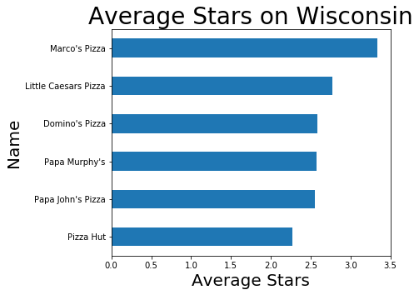
Top 10 Pizza
In Madison
Only six of top 10 pizza restaurant chain spread in Madison
Pizza Hut has twelve chains here

Slide 8
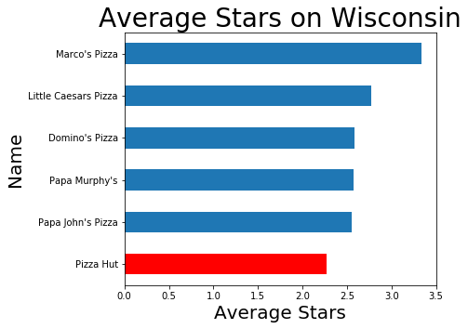
Pizza Hut
In Madison
Only six of top 10 pizza restaurant chain spread in Madison
Pizza Hut has twelve chains here
Pizza Hut does not preform well comparing to other pizza restaurant chains in Madison

Slide 9
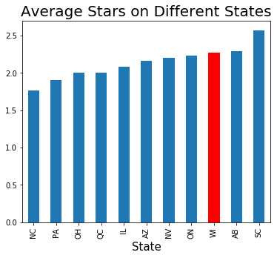
Pizza Hut
In Madison
Only six of top 10 pizza restaurant chain spread in Madison
Pizza Hut has twelve chains here
Pizza Hut does not preform well comparing to other pizza restaurant chains in Madison
Around the nation
Stars of reviews are close to each other except in South Carolina

Slide 10
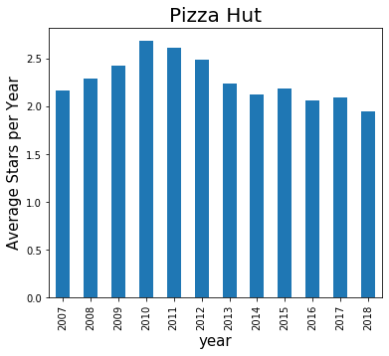
Pizza Hut
In Madison
Only six of top 10 pizza restaurant chain spread in Madison
Pizza Hut has twelve chains here
Pizza Hut does not preform well comparing to other pizza restaurant chains in Madison
Annual Performance
Substantial downward pressure from the reviews to Pizza Hut

Slide 11
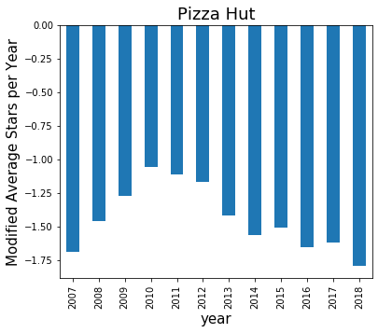
Pizza Hut
In Madison
Only six of top 10 pizza restaurant chain spread in Madison
Pizza Hut has twelve chains here
Pizza Hut does not preform well comparing to other pizza restaurant chains in Madison
Annual Performance
Substantial downward pressure from the reviews to Pizza Hut
After subtracting the annual average star of all reviews to the pizza restaurant

Slide 12
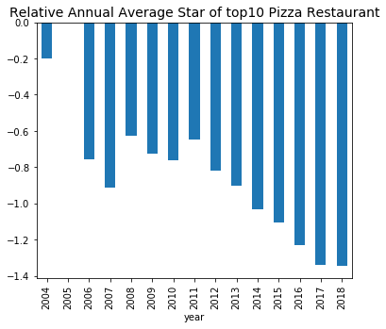
Top 10 Pizza
In Madison
Only six of top 10 pizza restaurant chain spread in Madison
All pizza restaurant franchise receive blow average reviews from their customers

Slide 13
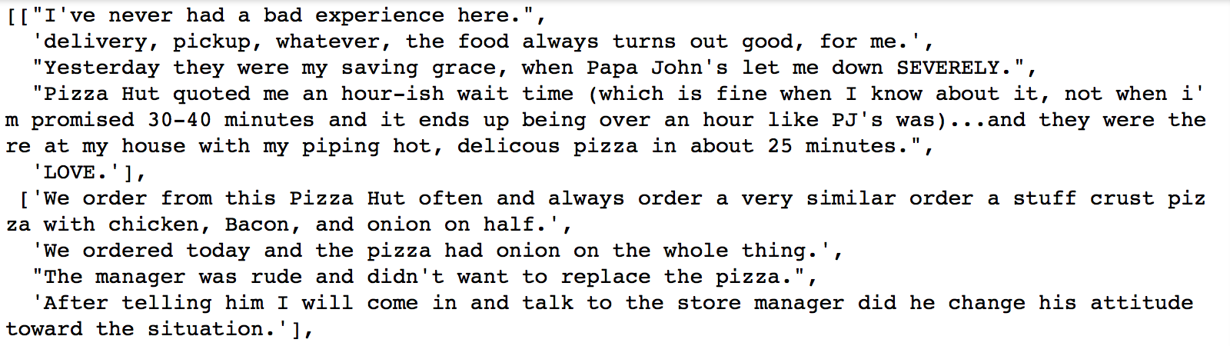
Review Data Cleaning -- Pizza Hut
Select the reviews from top 10 pizza restaurant.
Get reviews from Pizza Hut
Change these reviews into sentences

Slide 14
Get Basic ‘if’ suggestions
If they were not up for delivering that late, a curiosity call would be great so I don't sit at home hungry.
If that is peak, the web servers need to be replaced.
If you want a certain pizza then you'll have to make your voice heard or else they'll stick to their usual pepperoni, supreme, and cheese.

Slide 15
Further Data Cleaning without if sentences
Pronouns and positive helping verbs
Sentence pattern (”not only … but also’’=> “… and …”)
Negative abbreviation => helping verb + not
Combine negative adv with words behind : not great => notgreat
Delete punctuation marks
Combine negative patterns again further :
not great pizza => notgreatpizza

Slide 16
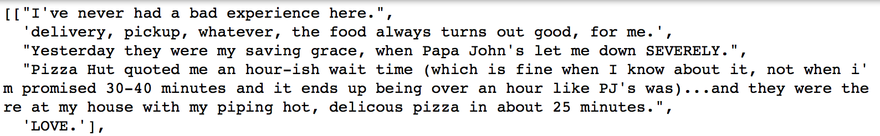
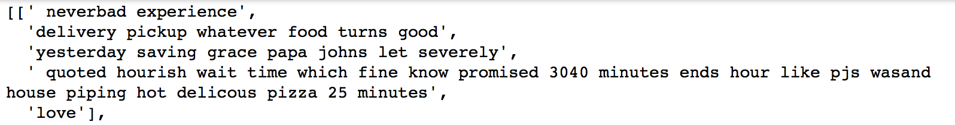
Further Data Cleaning without if sentences
Pronowns and positive helping verbs
Sentence pattern (”not only … but also’’)
Negative abbreviation => helping verb + not
Combine negative adv with words behind : not great => notgreat
Delete punctuation marks
Combine negative patterns again further :
not great pizza => notgreatpizza

Slide 17
Noun Vocabulary
Word | Count | Word | Count
pizza | 5037 | location | 1426
order | 3713 | minutes | 1382
time | 2174 | food | 1295
delivery | 1637 | place | 1059
service | 1566 | manager | 977
Adj Vocabulary
Word | Count | Word | Count
good | 1026 | worst | 445
great | 571 | bad | 442
first | 473 | wrong | 427
last | 465 | better | 425
well | 465 | large | 422

Slide 18
Not—Vocabulary
Word | Count | Word | Count
neverorder | 133 | notorder | 23
neveragain | 68 | nevereat | 22
nothing | 50 | never | 22
nevergo | 48 | nevercame | 21
nevergot | 42 | notback | 20
neverordering | 40 | notfeellike | 19
neverever | 36 | neverget | 19
neverproblem | 28 | neverreturn | 19
neverreceived | 24 | nevergoing | 16
notcare | 23 | notwastetime | 16

Slide 19
Future Plan
Mining more information from reviews.
Filter out common and useful information
Use RNN to acquire a new and reliable exact feedback
What kinds of reviews we should pay more attention to?

Slide 20
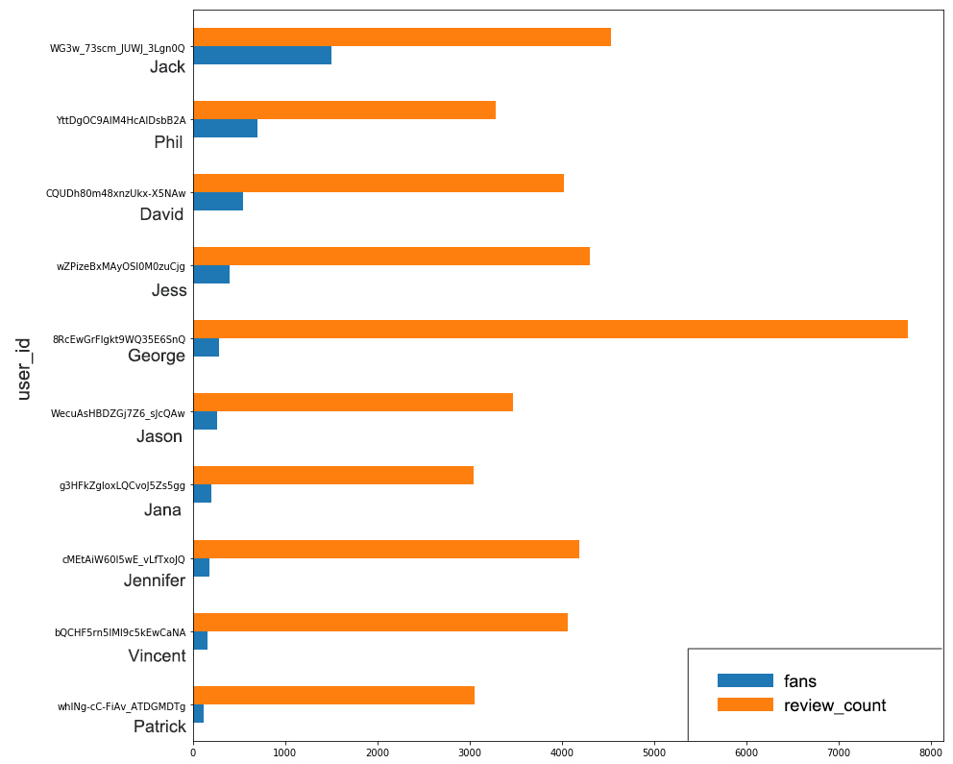
Future Plan
Add User Information
How many reviews did they wrote?
Could active users influence more people?

Slide 21
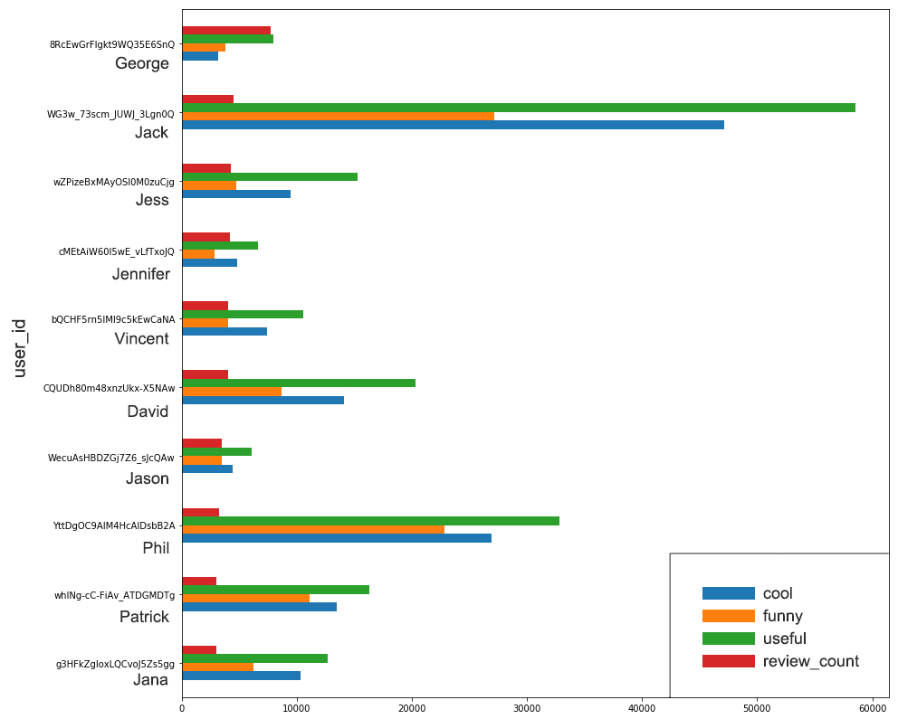
Future Plan
Add User Information
How many reviews did they wrote?
Could active users influence more people?
What do other users think of their reviews?
Is he/she an active user?

Slide 22
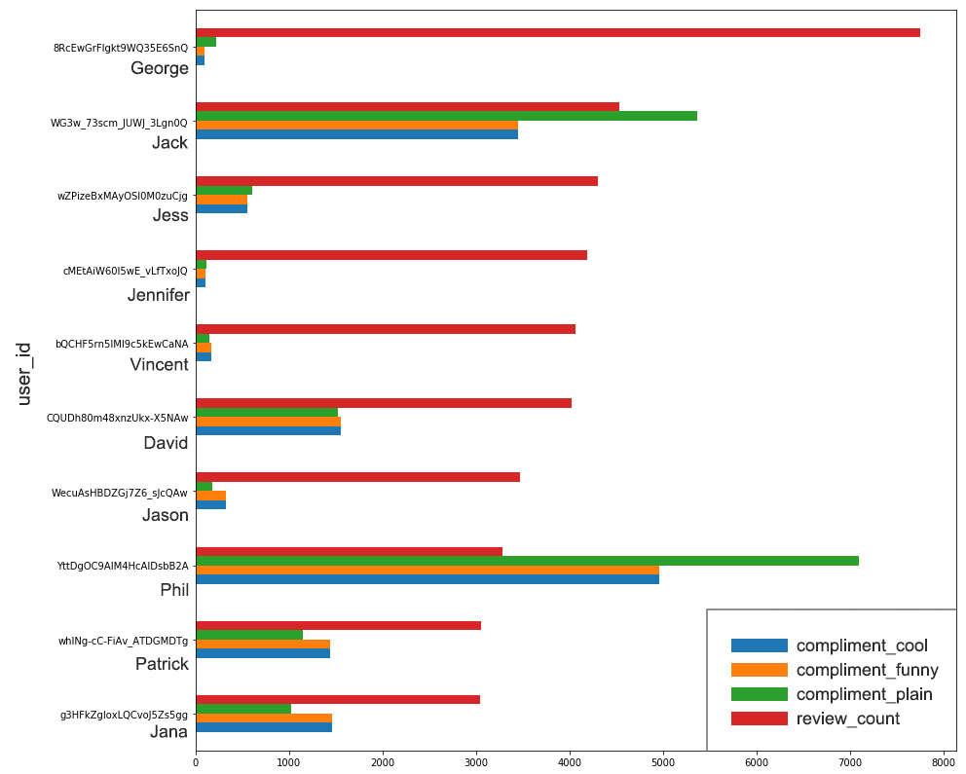
Future Plan
Add User Information
How many reviews did they wrote?
Could active users influence more people?
What do other users think of their reviews?
Is he/she an active user?
Is he/she an influential user?

Slide 23
Thank you!

